Slide 1
How To Easily Request the Aculist Reports You Want
Michelle Ronco
408-642-6970
michelleronco@aculist.com

Slide 2
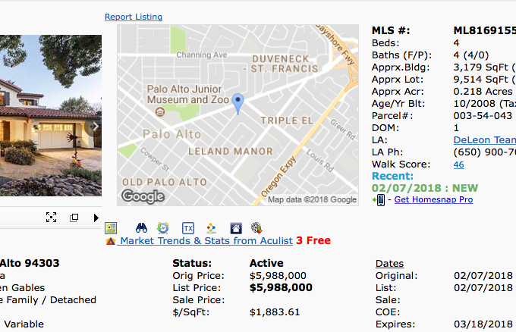
Step 1
Matrix Property Detail Page
  Agent Full Display
  Listings in San Mateo, Santa Clara, Santa Cruz, Monterey and San Benito Counties
Aculist link in Matrix

Slide 3
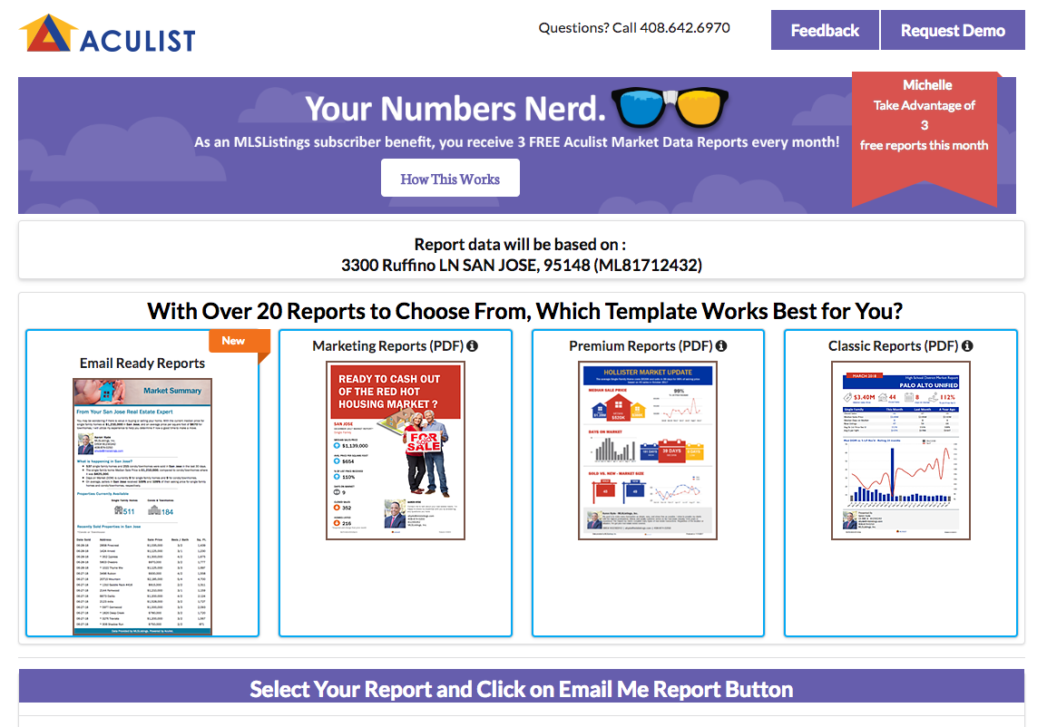
Numbers Nerd in Matrix
Free reports

Slide 4
Numbers Nerd in Matrix
* The property you selected in Matrix will be the foundation for the data that is provided.
A city report: San Jose
A MLS Area report: Evergreen
A ZIP code report: 95148

Slide 5
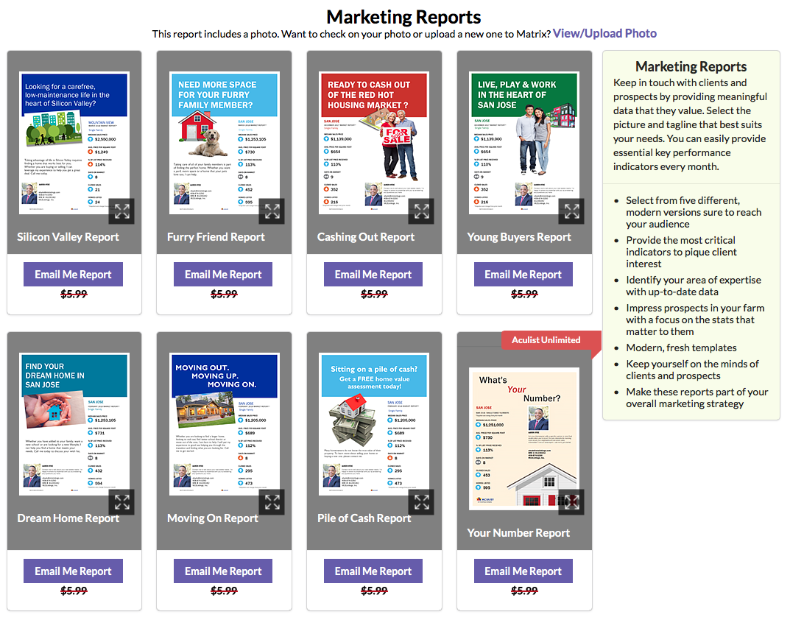
Step 2
1. Select a report
Note: You have already selected a listing.

Slide 6
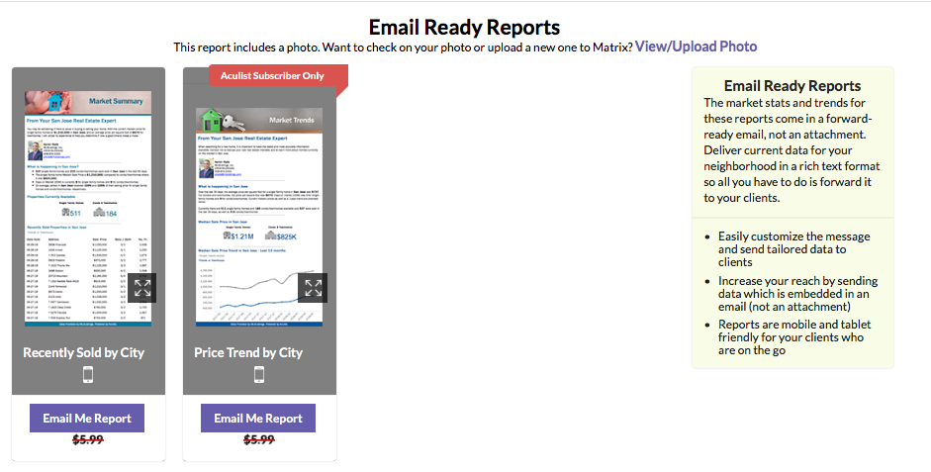
Step 3 – Choos an Email Ready Report
Request an Email Ready
Report

Slide 7
Step 3 – Choose a Marketing Report
Request a Marketing Report
* Aculist Unlimited reports are for Aculist Subscribers.

Slide 8
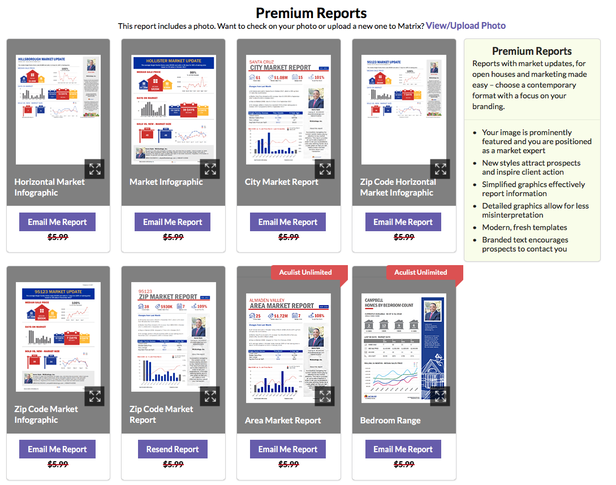
Step 3 – Choose a Premium Report
Request a Premium Report
* Aculist Unlimited reports are for Aculist Subscribers.

Slide 9
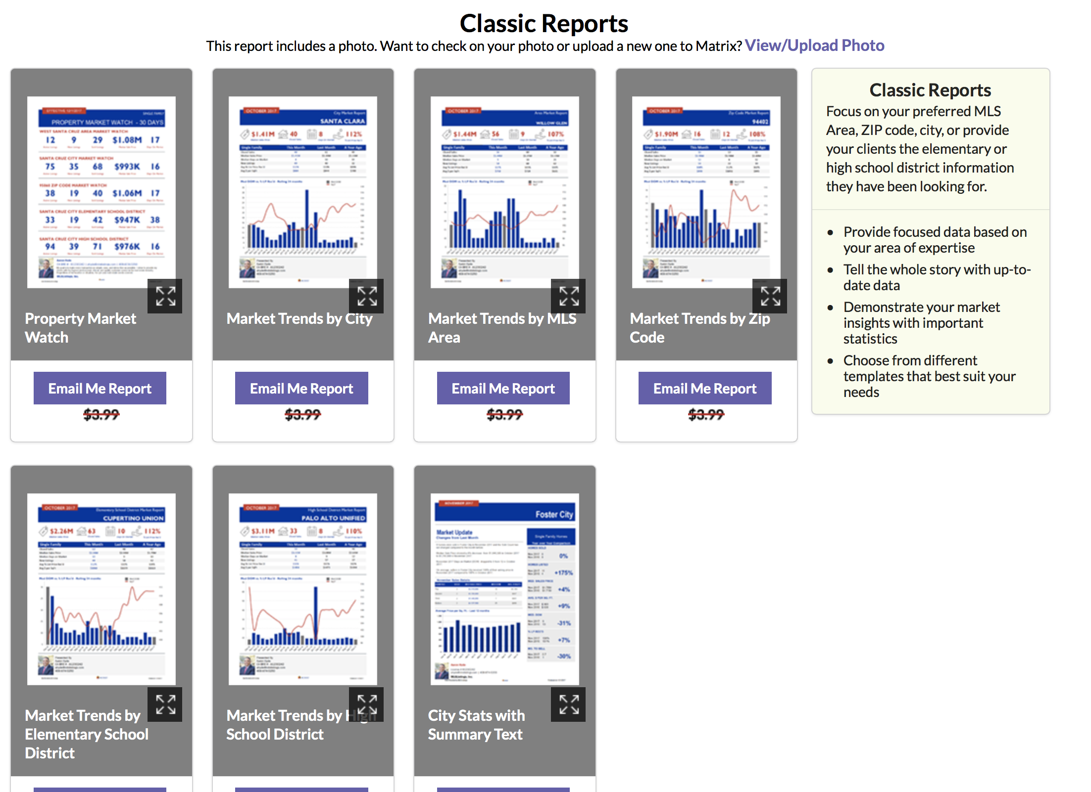
Step 3 – (or) Choose a Classic Report
Request a Classic
Report

Slide 10

Questions?
Do you have any suggestions or questions for our team?
Michelle Ronco
michelleronco@aculist.com
408-642-6970

Slide 11
Thank You

